Slide 1
B. Tech ECE FINAL YEAR PROJECT –FINAL REVIEW
Remote Health-Monitoring System with auto-diagnosis feature
Based on Machine-to-Machine (M2M) technology, we propose a system to remotely monitor health of cardiovascular patients. The system gathers all information regarding current health condition of the patient and automatically diagnoses the data to suggest medication to the patient. To provide surety to the patient, the same report is sent to his doctor who verifies the medication report.

Slide 2

Group Members- Saurav Mohapatra (15BEC0002) Sunderam Sah (15BEC0004) Arka Provo Mukhopadhyay (15BEC0402)
Under Guidance of
Prof. Budhaditya Bhattacharya
Associate Professor
Department of Communication Engineering

Slide 3
Objective
Gather cardiac data from various sensors.
Implement a Chat-Bot System to interview the patient.
Implement and predict among few ML algorithms which produce best result for auto-diagnosis.
Send the final report for doctor’s verification (who is at far away place).

Slide 4


Slide 5
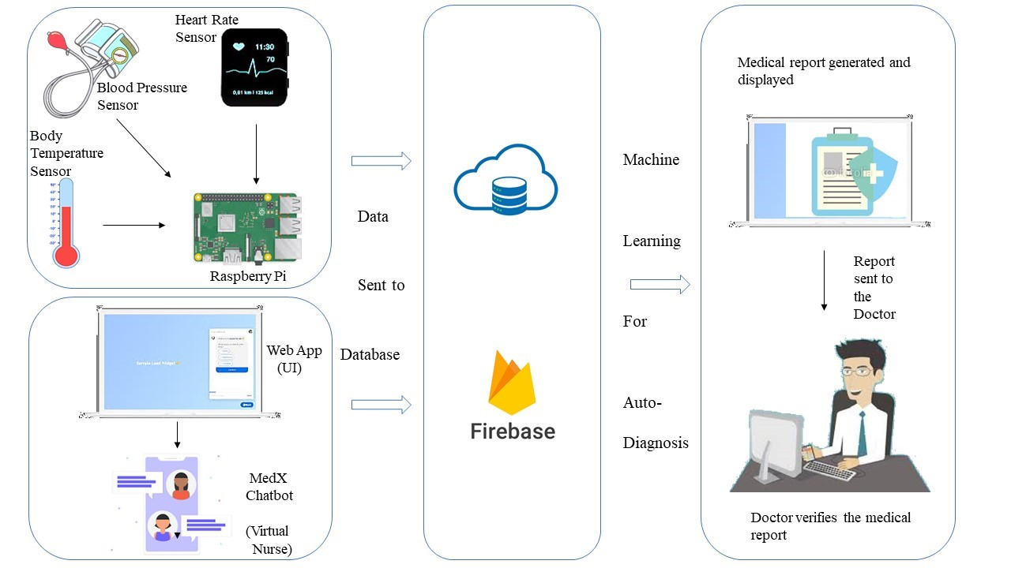
Methodology

Slide 6
Literature Survey
“Cardiovascular disease in Europe”- M. Rayner, S. Allender and P. Scarborough, European Journal of Cardiovascular Prevention & Rehabilitation
The extent and nature of burden created by Cardiovascular Diseases (CVD) in Europe is discussed.
As per World Health Organisation (WHO), there are around 4.3 million mortalities per year due to CVD, which is very high!!
The lifestyle of people (smoking, poor diet, alcohol consumption) and improper health check-ups are some reasons for causing CVD.
Hence, this paper thoroughly studies the effects caused by CVD and rehabilitation strategies.

Slide 7
Literature Survey (Continued)
Enriko, I. K. A., Suryanegara, M., & Gunawan, D. My Kardio: A Telemedicine System Based on Machine-to-Machine (M2M) Technology for Cardiovascular Patients in Rural Areas with Auto-Diagnosis Feature Using k-Nearest Neighbor Algorithm.
An M2M based telemedicine system named “MyKardio” is proposed which automatically diagnoses cardiovascular diseases in patients remotely, especially in rural areas with lack of doctors. The system at the patient site gathers data from various sensors and interview taken by the nurse, then it automatically diagnoses the results using K-NN machine learning algorithm and finally prescribes its medication. For doctor’s verification, the same report is sent to him.

Slide 8
Hardware & Software Used
Raspberry Pi
Sunrom BP sensor – For measuring Blood Pressure & Heart Rate
Temperature Sensor (DSB18B20) – For measuring body temperature
Chatbot (using Google API) – Interviewing the patient
ML Algorithms (kNN, SVM, RF) – For auto-diagnosis
EasyPHPDevServer – For sending report to doctor
TFT Display – For displaying medication report

Slide 9
Hardware Tools
Raspberry Pi- The Raspberry Pi 3 Model B features a quad-core 64-bit ARM Cortex A53 clocked at 1.2 GHz. The Pi 3 now includes on-board 802.11n WiFi and Bluetooth 4.0. It has 4 USB ports. It has 10/100 MBPS Ethernet.
Sunrom BP sensor - There are two types of blood pressure ‘systolic’ (when the heart beats) and ‘diastolic’ (when the heart relaxes between the beat), this device measures both of them and shows the reading. It also as a pulse sensor embedded in it, which measures the heart rate (in beats per minute, bpm). Output data goes to microcontroller via serial module provided by the manufacturer.
DSB18B20 - It is the size of a transistor and transmits data to the microcontroller through only one wire but it needs three wires for operation i.e. VCC, Ground and Data wires. It is made up of silicon and have A/D convertor memory to temporarily store the data. It can sense temperature in the range of -55°C to 125°C.

Slide 10
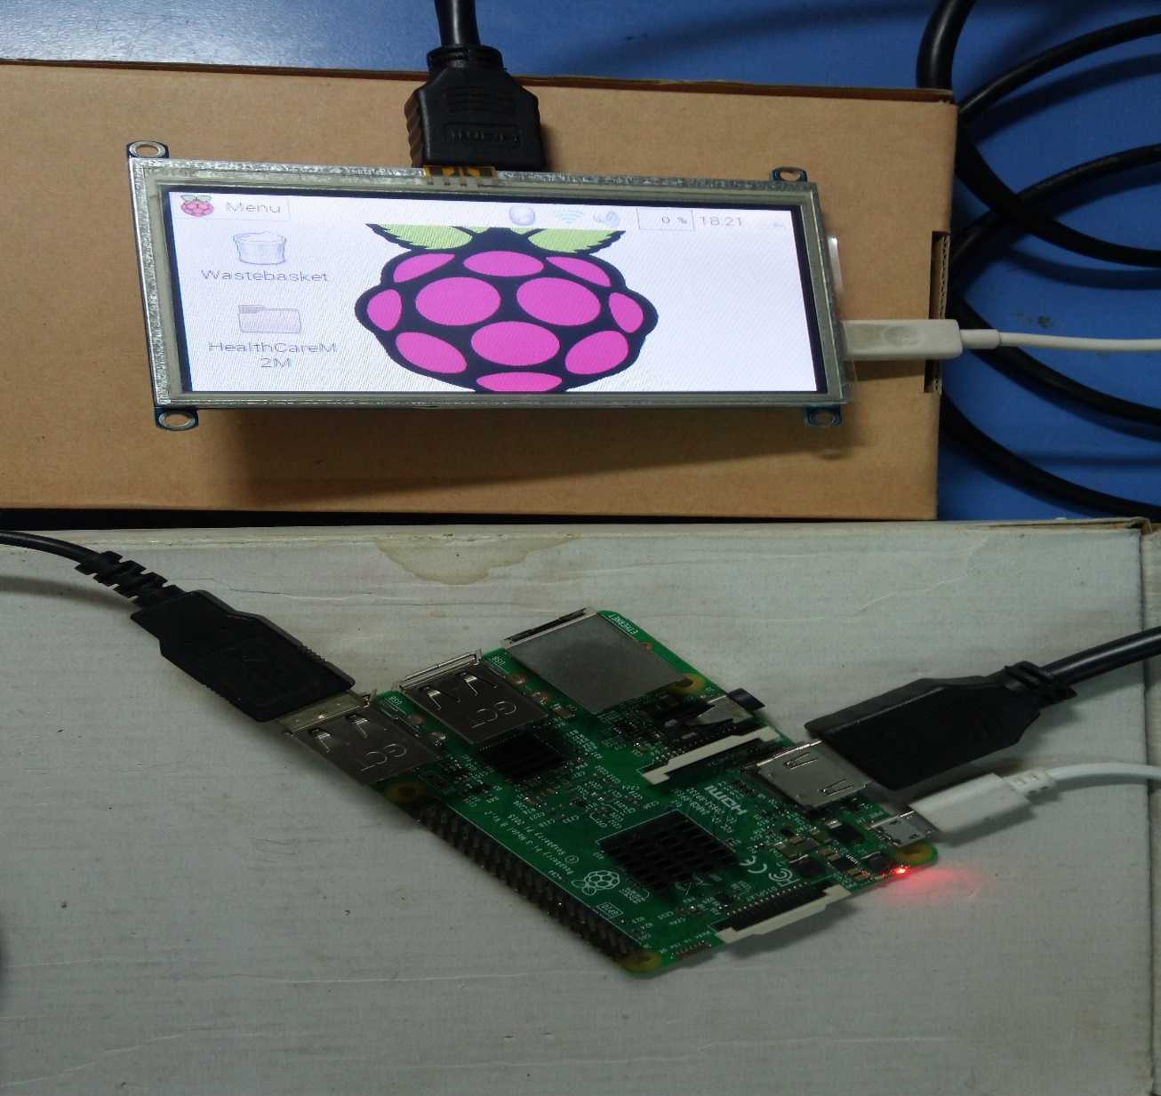
Raspberry Pi + TFT Display unit

Slide 11
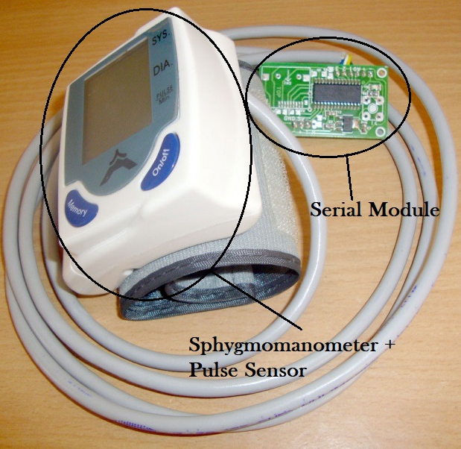
Sunrom BP + Heart Rate Sensor Module

Slide 12
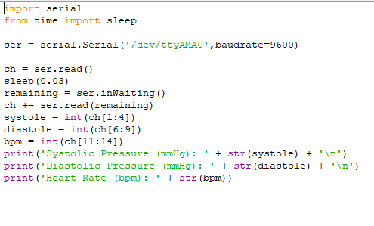
Code Implementation of BP+ Heart Rate Sensor Module (Python)

Slide 13
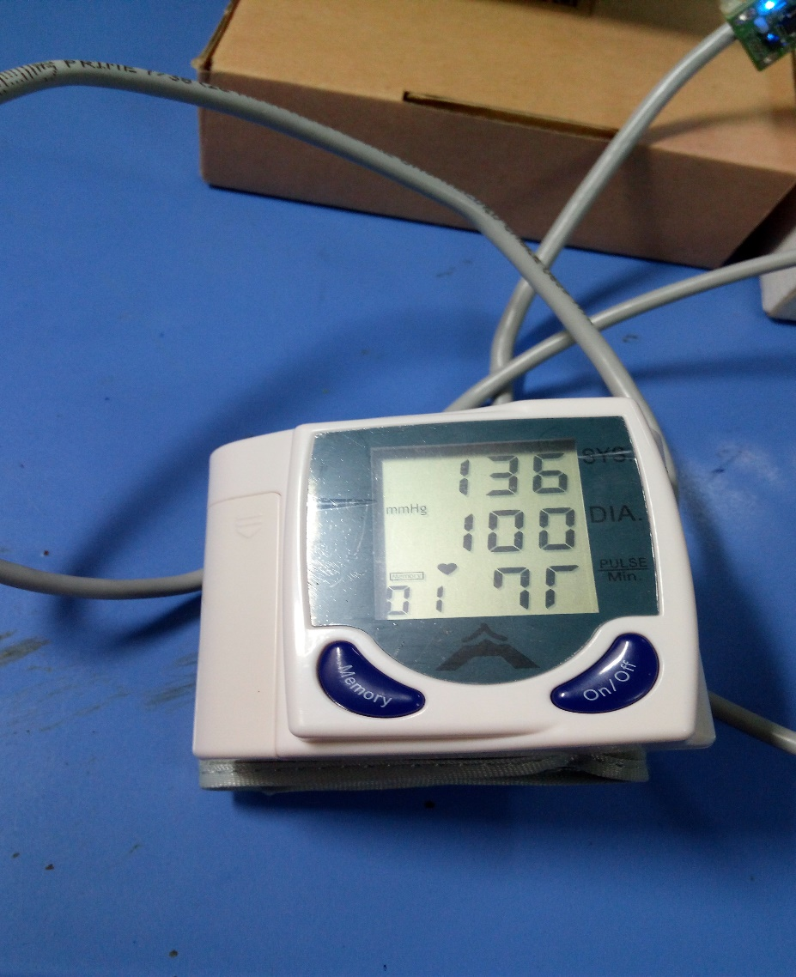
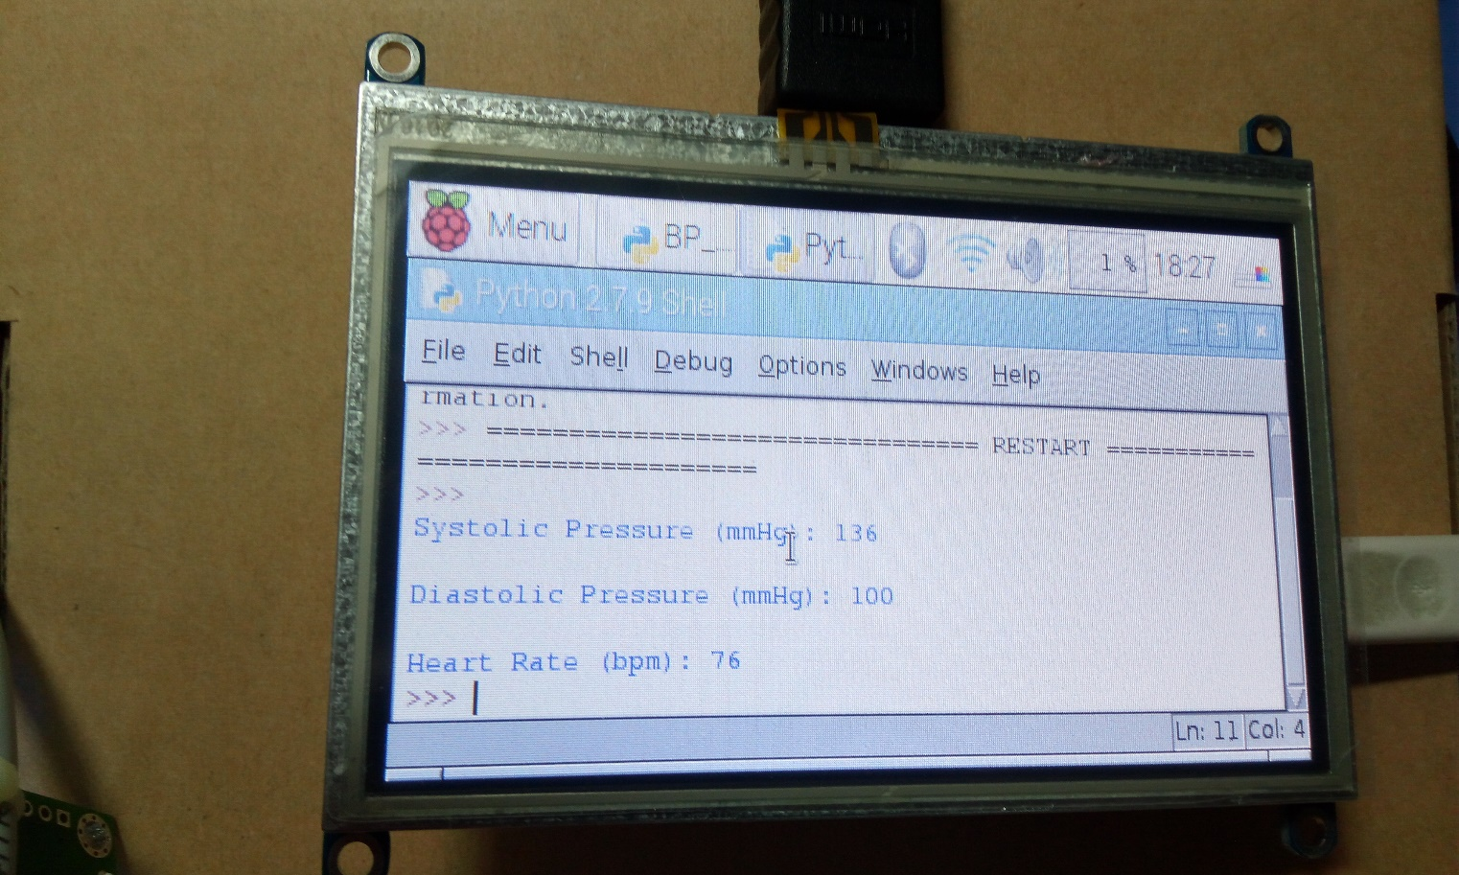
Implementation of BP+ Heart Rate Sensor

Slide 14
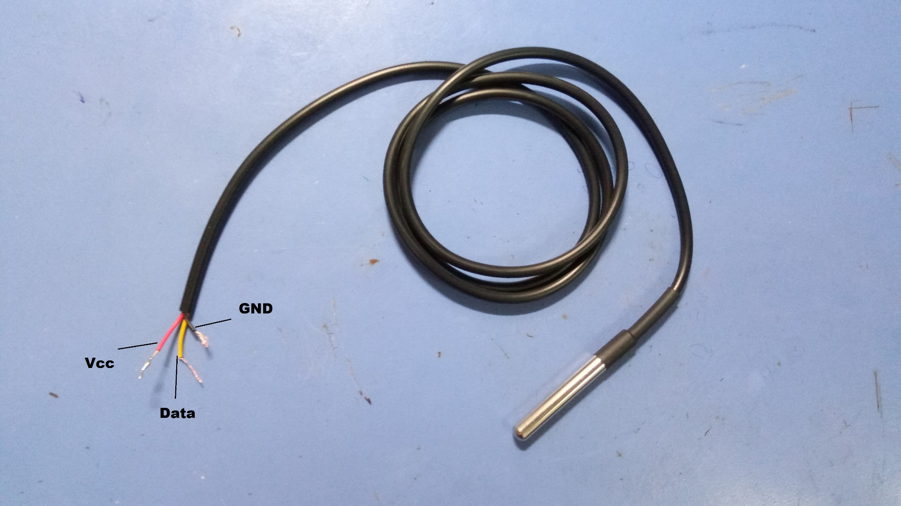
Temperature Sensor (DSB18B20)+ Probe

Slide 15
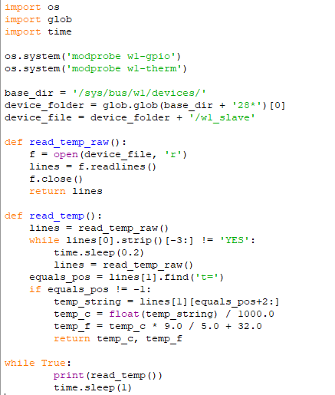
Code Implementation of DSB18B20 (python)

Slide 16
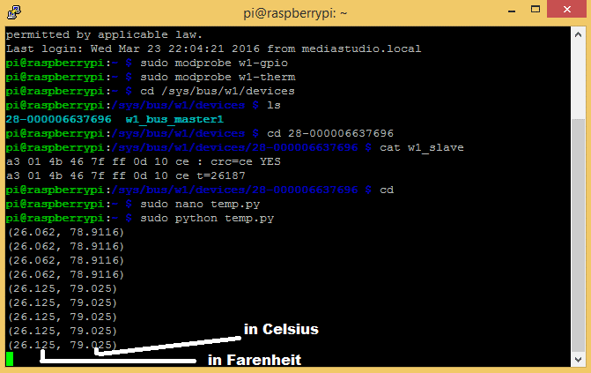
Temperature values in RPi Terminal

Slide 17
Chatbot Implementation
Chatbots are generally used in dialog systems for various practical purposes and use sophisticated Natural Language Processing (NLP) systems.
We developed our chatbot in ‘Dialogflow’, a Google-owned service for human computer interaction based on NLP.
This chatbot behaves as a virtual doctor in terms of conversation, treatments and suggestions to improve the mental health of patients.

Slide 18
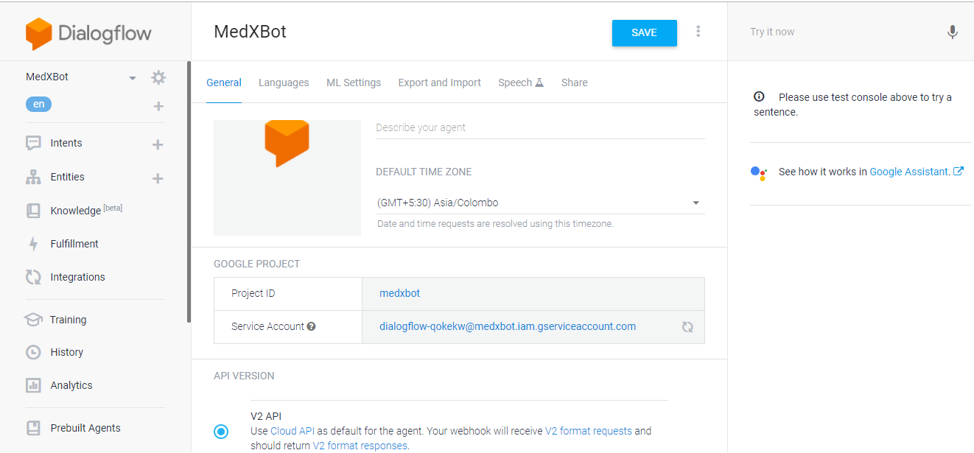
Step0: Create an agent

Slide 19
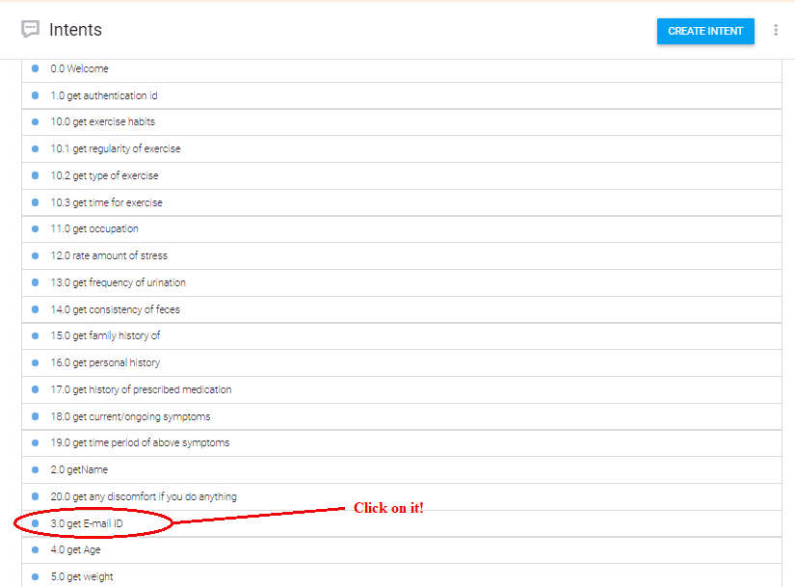
Step1: Intents inside agent

Slide 20
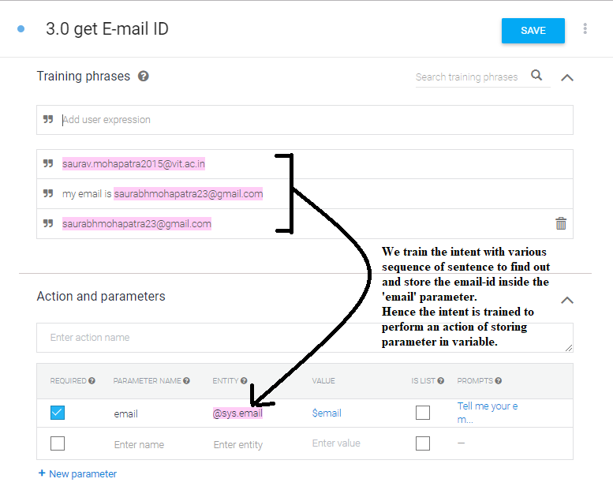
Step2: Training & Actions inside intent

Slide 21
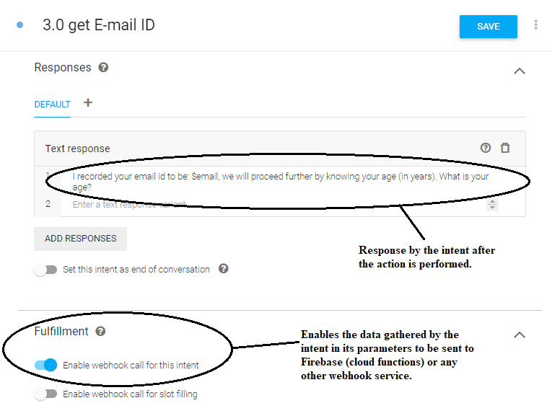
Step3: Response & Fulfilment inside intent

Slide 22
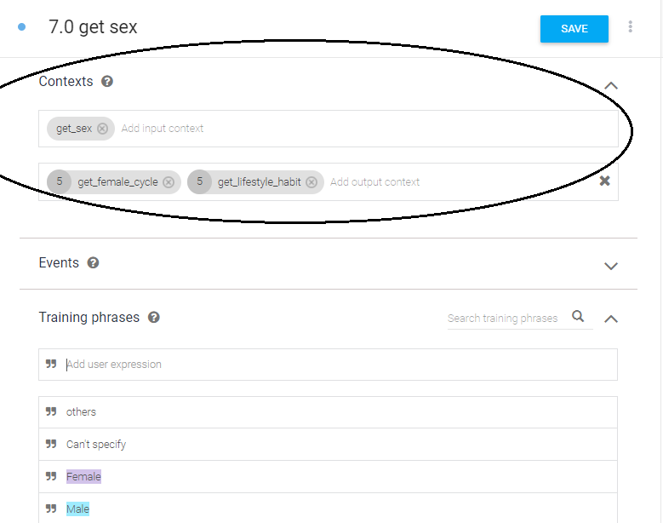
Step4: Contexts to connect all intents

Slide 23
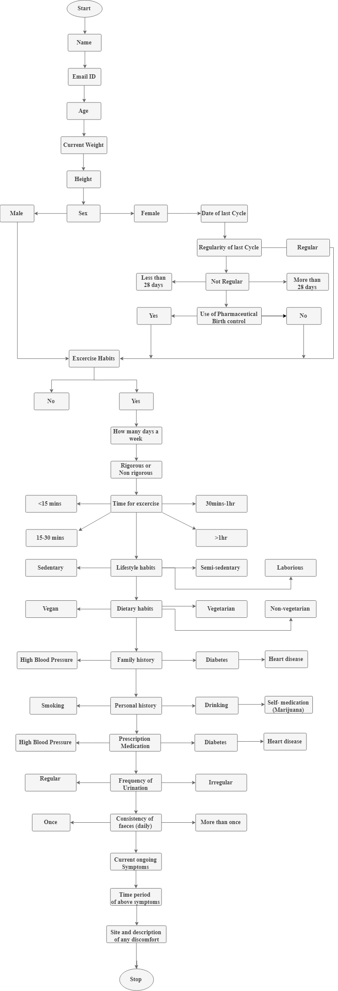
Chatbot Questionnaire

Slide 25
Machine Learning Algorithms
1. Logistic Regression (LR)
5. K- Means Naïve Bayes (KNMB)
E
X
I
S
T
I
N
G
P
R
O
P
O
S
E
D
2. Random
Forest
(RF)
6. Fuzzy K-Nearest Neighbour (FKNN)
ML
3. Boosted
Tree
(BT)
7. Neural Networks (NN)

Slide 26
UCI Heart disease Dataset for ML [12]
Variable (parameter) | Short description | Values
Age | Age of patient | Continuous
Sex | Sex of patient (male/female) | 0=Male, 1=Female
Chest pain | Three types (anginal/ non-anginal/ asymptomatic) | 4 = Typical type 3 = Atypical type angina 2 = Non­angina pain 1 = Asymptotic
Bpm or Thalach | Max Heart rate achieved by patient | Continous
(Sys, Dia) or Thest bps | Resting Blood pressure of patient (Sys- Systolic, Dia- Diastolic) | Continuous
Chole | Resting Blood sugar level or Serum Cholestrol | Continuous
Fbg | Fasting Blood sugar larger than resting Blood sugar (Yes/No) | 1 >= 120 mg/dl 0 <= 120 mg/dl
Rest ECG | Resting ECG result | 5 = normal 4 = having ST_T wave abnormal 3 = left ventricular hypertrophy
Exercise | Induced angina (yes/no) | 1 = no 2 = yes
Old peak | ST depression induced by exercise relative to rest | Continous
Exercise_slope or Old peak | Peak time and effort given for laborious work- Slope of the height effect ST section | 3 = un sloping 2 = flat 1 = downsloping
Ca | Number of major vessel (colored by fluoroscopy) | 1­4 value
Thal | Thallium heart scan | 2 = Normal 4 = Fixed 5 = Reversible defect
Num | Diagnosis of heart disease | No disease & Heart disease

Slide 27

Logistic Regression (LR)
Logistic regression or multinomial logistic regression generalizes to multiclass classification by apprehending a vector of variables and evaluating the coefficients or weights for each input parameter that has been detected and then identifies the medication.

Slide 28

Random Forest Classifier (RF)
It has mixture of tree classifiers where every single classifier is made using a random vector divided independently from input vector, a tree builds unit vote for most renowned class to identify an input vector.

Slide 29
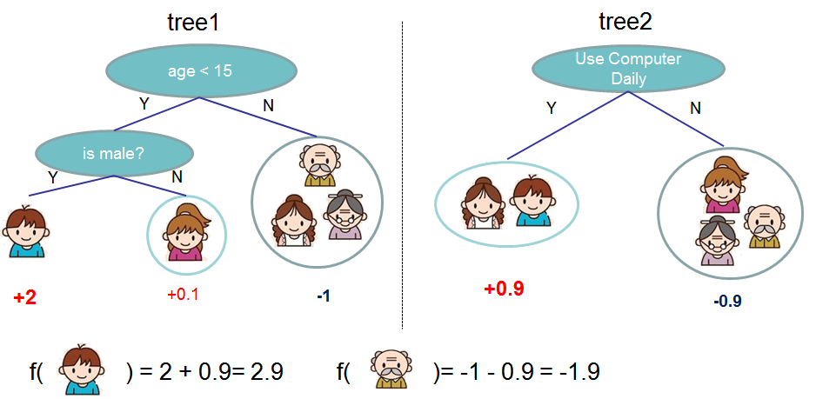
Boosted Tree Classifier (BT)
Boosting is general way used for enhancing the accuracy of a learning algorithm. More importantly, it works on the principle that a “strong” classifier (highly accurate is generated through the linear combination of a lot of “weak” classifiers (less accurate).

Slide 30
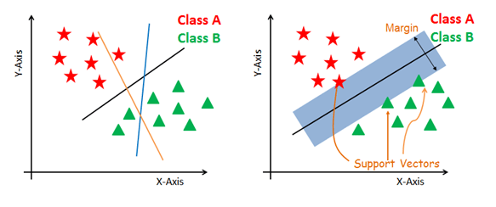
Support Vector Machine (SVM)
SVM is type of linear classifier, a class of supervised learning model, which is used to separate the data into different classes by a hyper plane for N dimensional data. The model has linear classification and can perform nonlinear classification using kernel trick, thereby mapping the input features to higher dimensional feature spaces.

Slide 31
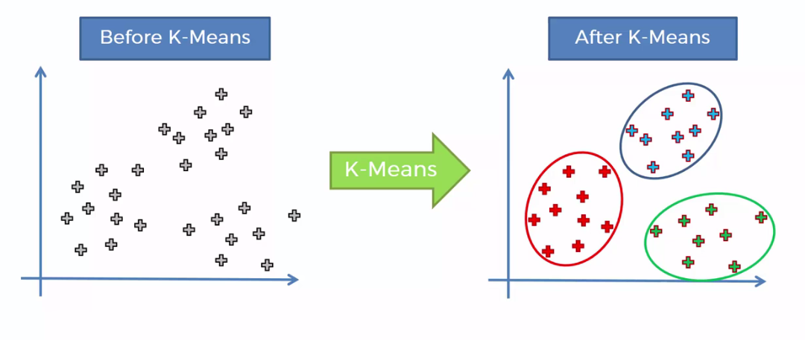
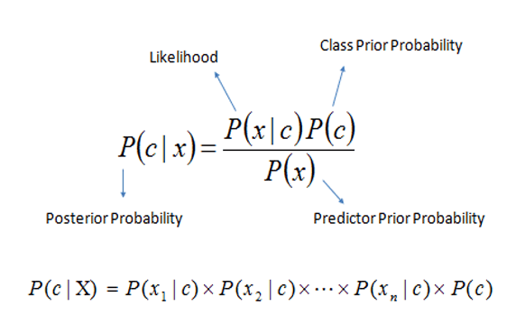
K-Means Clustering with Naive Bayes (KMNB)
KMNB algorithm is implemented by summing classification and clustering techniques. For grouping similar kind of data in former stage, KMNB is used as a pre-classification component. In the next stage, the data will be classified by category of attack using Naïve Bayes classifier. So the misclassified data (from the first stage) will be classified accordingly by its category in the second stage.

Slide 32
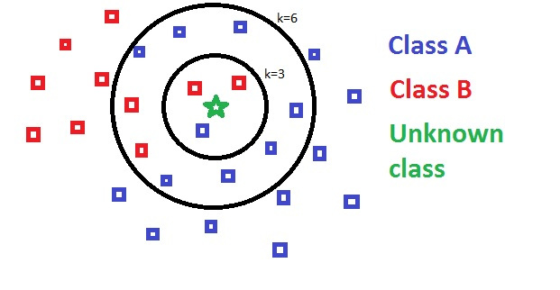
Fuzzy K-Nearest Neighbor (FKNN)
The main improvement of using the FKNN over KNN is that despite its deterministic form, the unbiased weighting of instances is considered in the decision rule regardless of its distance to the pattern to be classified. In this case, closer neighbors of a query point will have a greater influence than neighbors which are further away which leads the fuzzy form to have greater accuracy.

Slide 33
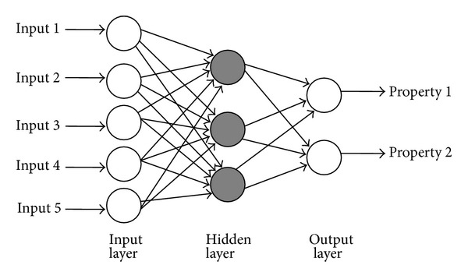
Neural Networks (NN)
The neural network has 3 layers – an input layer, a hidden layer, and an output layer. It uses forward propagation to compute (hθ(x^{i}))k, the activation (output value) of the k­th output unit and θ represents the weights. The code works for any number of input units, hidden units and outputs units.

Slide 34
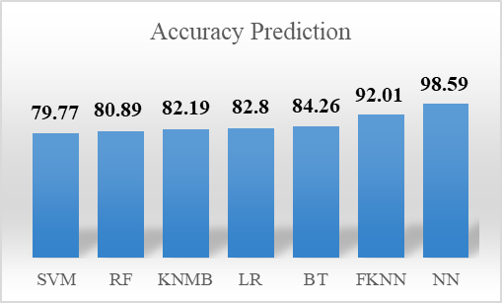
Prediction Accuracy Results
After comparing all the 7 ML algorithms, we get the following result-

Slide 35
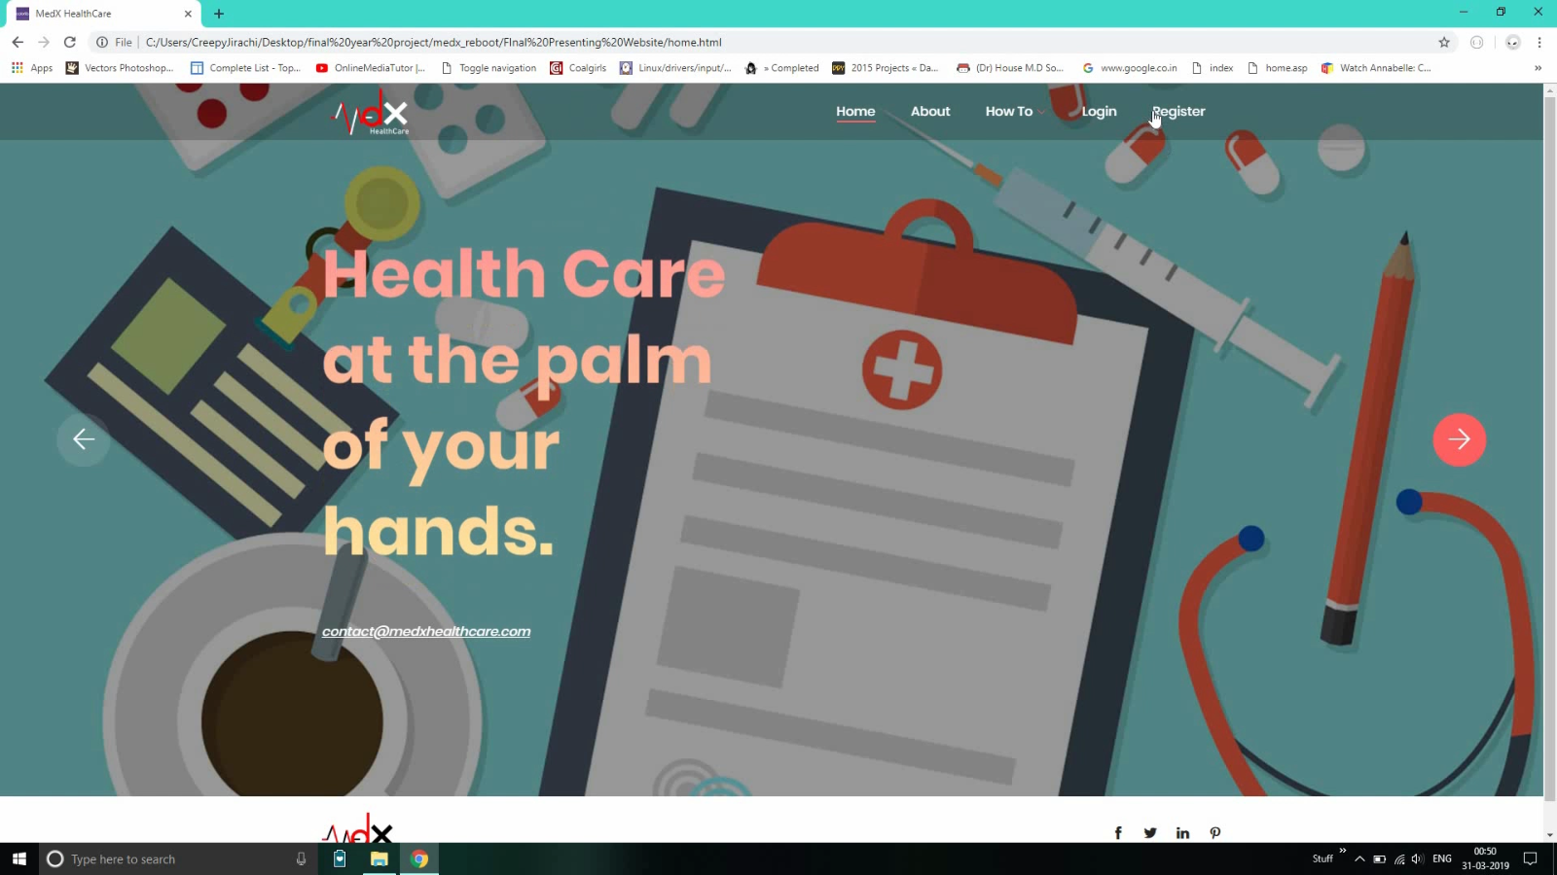
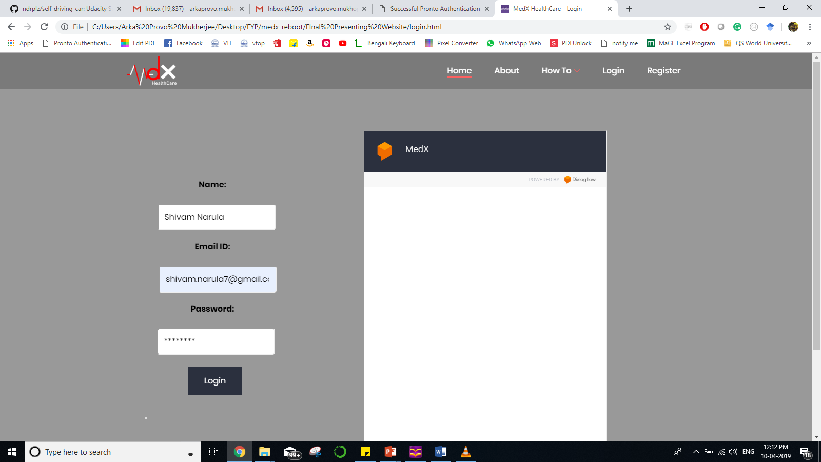
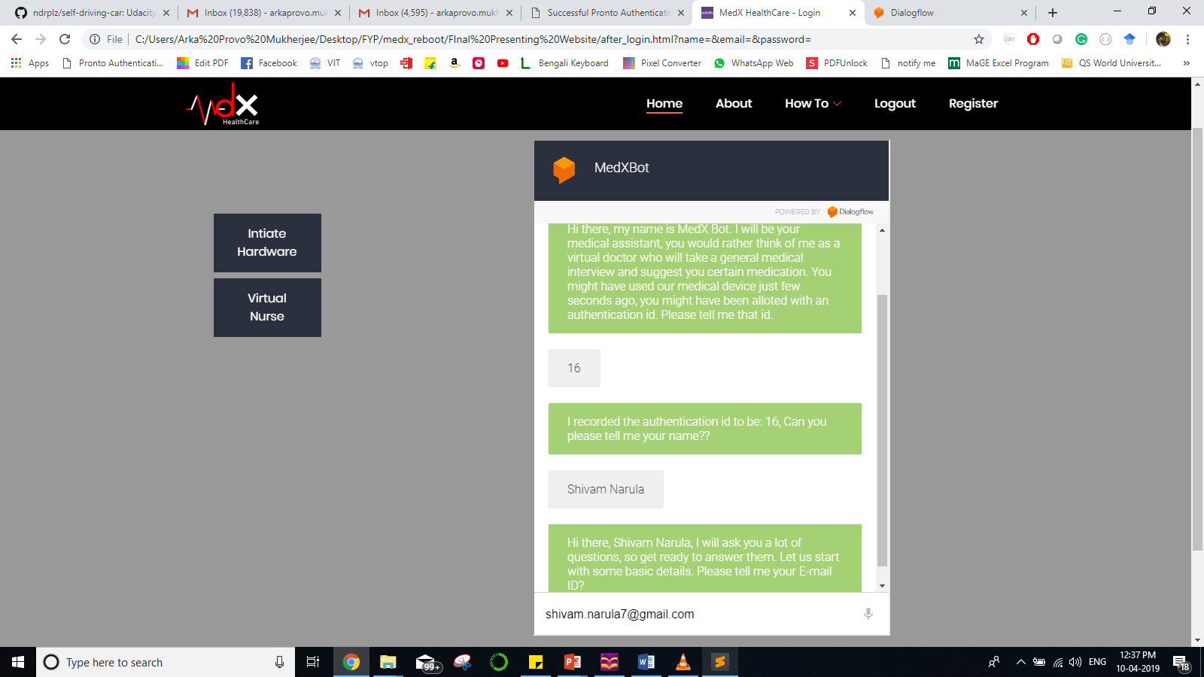
User Interface design

Slide 36
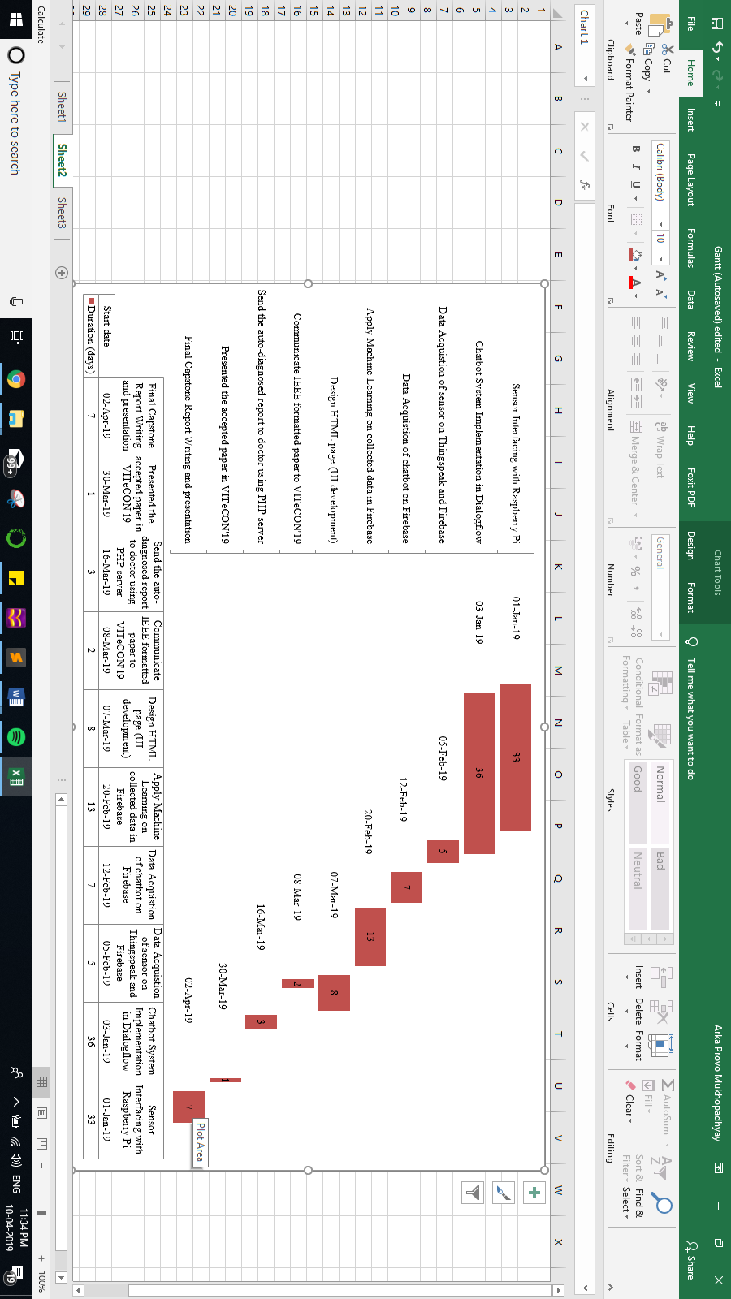
Time Line

Slide 37
Conclusion
The project can be used as an important tool for doctors and healthcare organizations to predict certain critical cases in the practice and used to advise the patient accordingly. The model from the classification will be able to answer more complex queries in the prediction of heart attack diseases.
From complete analysis, we find out that Neural Networks (NN) performs the best among all algorithms in predicting the test samples over the training dataset. The reason is- As we train the network with more and more samples it updates its weights continuously to store them. Thus, next time we feed any test sample, it predict with highest accuracy possible.

Slide 38
References
[1] Gupta, A., Lampropulos, J. F., Bikdeli, B., Mody, P., Chen, R., Kulkarni, V. T., ... & Editor. (2013). Most important outcomes research papers on cardiovascular disease in women. Circulation: Cardiovascular Quality and Outcomes, 6(1), e1-e7.
[2] Chauhan, S., & Aeri, B. T. (2015). The rising incidence of cardiovascular diseases in India: Assessing its economic impact. J. Preventive Cardiology, 4.
[3] Prabhakaran, D., Jeemon, P., & Roy, A. (2016). Cardiovascular diseases in India: current epidemiology and future directions. Circulation, 133(16), 1605-1620.
[4] Marso, S. P., Daniels, G. H., Brown-Frandsen, K., Kristensen, P., Mann, J. F., Nauck, M. A., ... & Steinberg, W. M. (2016). Liraglutide and cardiovascular outcomes in type 2 diabetes. New England Journal of Medicine, 375(4), 311-322.
[5] Balambigai, S., & Jeevitha, P. (2017, January). A survey on investigation of vital human parameters from photoplethsmography signal to predict the risk of cardiovascular diseases. In Advanced Computing and Communication Systems (ICACCS), 2017 4th International Conference on (pp. 1-4). IEEE.

Slide 39
References (continued)
[6] Reyes, I., Nazeran, H., Franco, M., & Haltiwanger, E. (2012, August). Wireless photoplethysmographic device for heart rate variability signal acquisition and analysis. In 34th Annual International Conference of the IEEE EMBS San Diego, California USA (Vol. 28).
[7] Visvanathan, A., Sinha, A., & Pal, A. (2013, November). Estimation of blood pressure levels from reflective Photoplethysmograph using smart phones. In Bioinformatics and Bioengineering (BIBE), 2013 IEEE 13th International Conference on (pp. 1-5). IEEE.
[8] Monte-Moreno, E. (2011). Non-invasive estimate of blood glucose and blood pressure from a photoplethysmograph by means of machine learning techniques. Artificial intelligence in medicine, 53(2), 127-138.
[9] Enriko, I. K. A., Wibisono, G., & Gunawan, D. (2015, May). Designing machine-to-machine (M2M) system in health-cure modeling for cardiovascular disease patients: Initial study. In Information and Communication Technology (ICoICT), 2015 3rd International Conference on (pp. 528-532). IEEE.
[10] Aamodt, A., & Plaza, E. (1994). Case-based reasoning: Foundational issues, methodological variations, and system approaches. AI communications, 7(1), 39-59.
[11] Enriko, I. K. A., Suryanegara, M., & Gunawan, D. My Kardio: A Telemedicine System Based on Machine-to-Machine (M2M) Technology for Cardiovascular Patients in Rural Areas with Auto-Diagnosis Feature Using k-Nearest Neighbor Algorithm.
[12] UCI Heart Disease Databases, David Aha, July 22, 1988, https://archive.ics.uci.edu/ml/machine-learning-databases/heart-disease/heart-disease.names

